Slide 1
MRA Project Milestone-2
BY- Deepti Agrawal
PGPDSBA Online Nov_2020
deepti.agl2912@gmail.com

Slide 2
TABLE OF CONTENTS
Problem Statement
Data Analysis
Exploratory Data Analysis
  Univariate
  Bivariate
  Multivariate
Devising association rules using Market Basket Analysis
  Output table
  Tools used, parameters and assumptions
  KNIME Workflow
RFM Inferences
  Recommendations
  Possible Combos/Suggestive discounts

Slide 3
PROBLEM STATEMENT
A Grocery Store shared the transactional data with you. Our job is to identify the most popular combos that can be suggested to the Grocery Store chain after a thorough analysis of the most commonly occurring sets of items in the customer orders. The Store doesn’t have any combo offers. We need to suggest the best combos & offers.

Slide 4

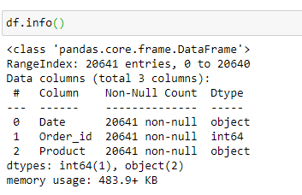
DATA ANALYSIS
Data Shape:
Data Info:
The Dataset has 20641 transactions of a grocery store with 3 attributes as:
-Date: date of transaction (date type),
-Order_id: unique order number(integer type)
-Product: description of product purchased in an order.(object type)
Data does not having any null, duplicate or missing values.

Slide 5
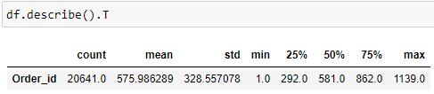
DATA ANALYSIS
Data Summary:
Here, Order_id is considered as an integer therefore, its statistics are calculated.
But, in reference to our data, Order_id is a unique index (categorical)

Slide 6
Exploratory Data Analysis
Understanding Trends in Data
Visualizing Univariate, Bivariate and Multivariate Graphs through Tableau

Slide 7
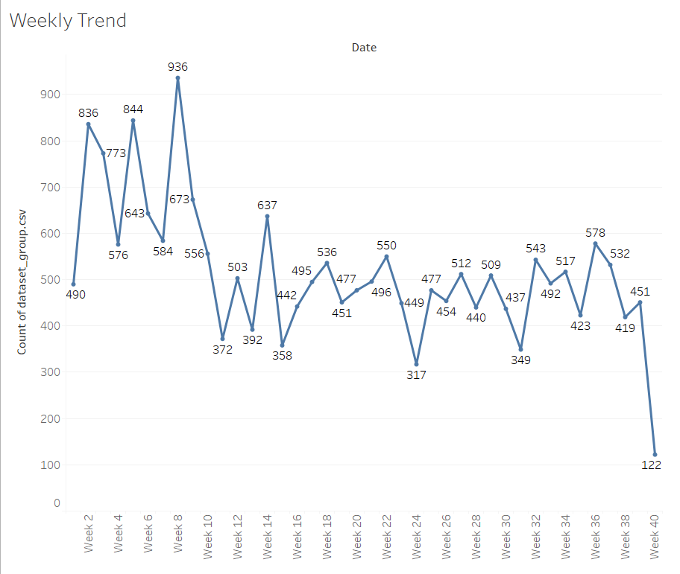
WEEKLY TREND IN ORDERS
Week 8 shows the highest Orders and there is a steep downfall from Week 9 to week 11

Slide 8
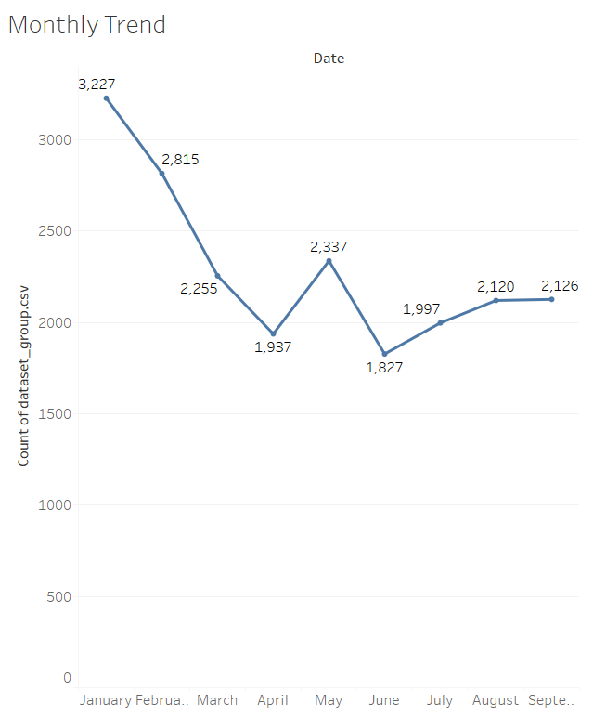
MONTHLY TREND IN ORDERS
Highest orders are received during starting months of the year.

Slide 9
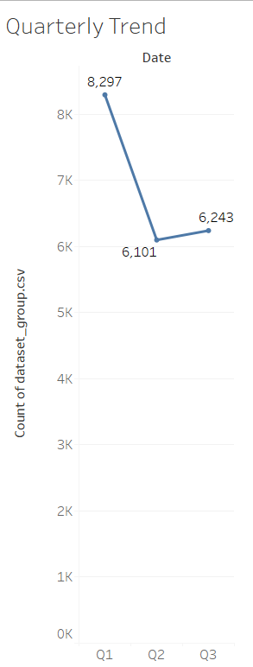
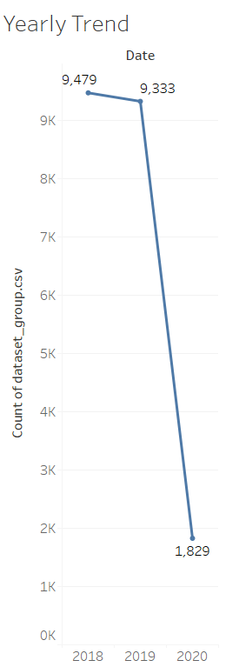
Quarterly Trend in Orders
Yearly Trend in Orders
Sales increased drastically from Q1 to Q2
Year 2018 and 2019 recorded
almost similar number of orders

Slide 10
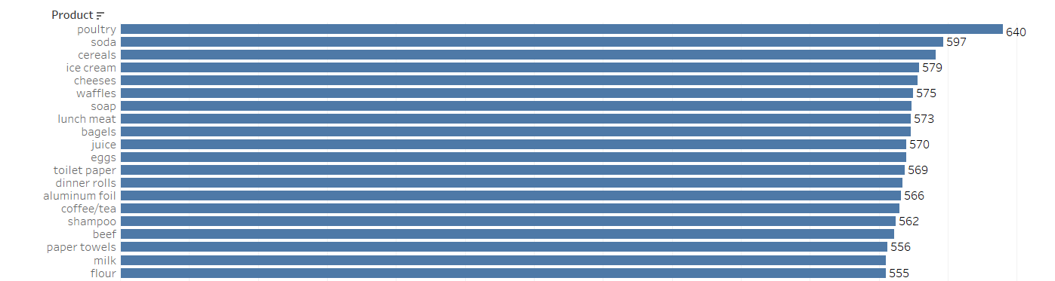
High Demand Products
Poultry is the hot selling product of this grocery store, followed by Soda and cereals.

Slide 11
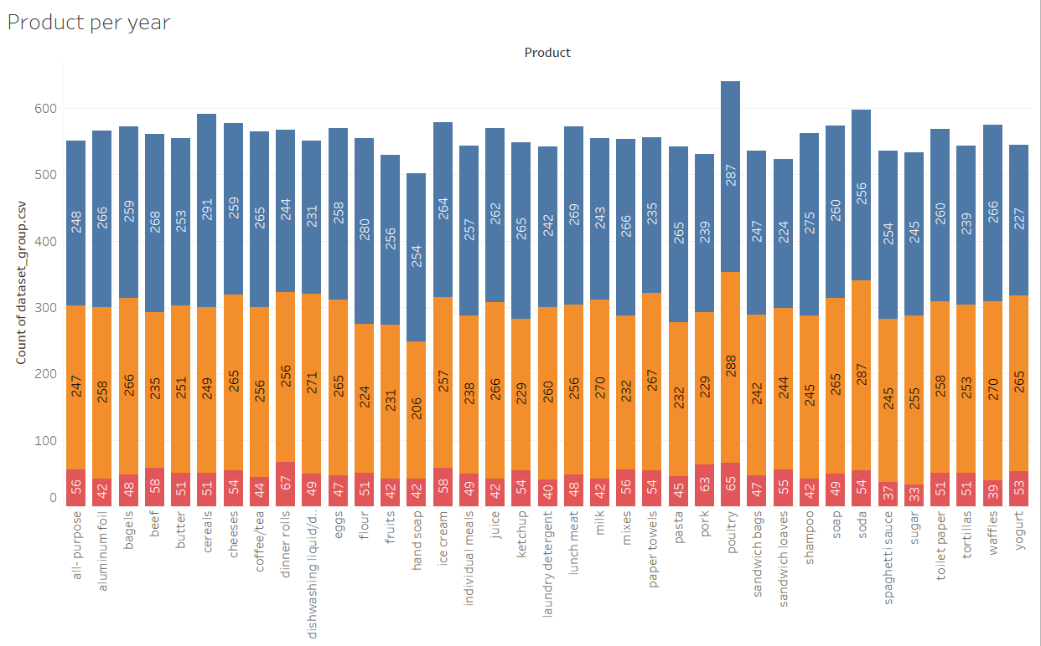
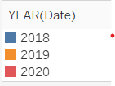
Product Quantity ordered per year

Slide 12
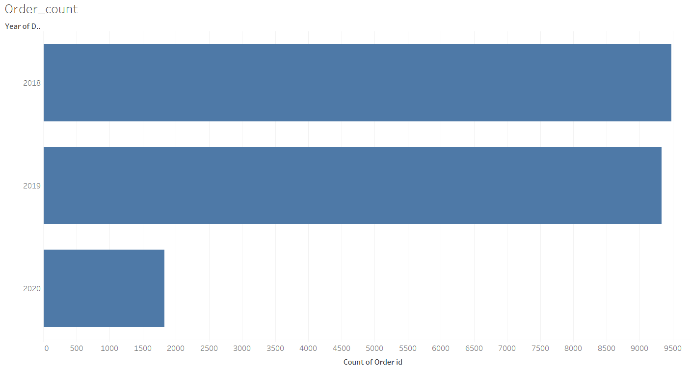
Number of orders per year

Slide 13
Inferences:
Our data consists of 20641 product orders of a grocery store in the year 2018,
2019 and 2020
Maximum orders are received during starting of every year.
The first quarter shows good no. of orders.
Poultry is the highest ordered product followed by soda, cereals and icecream.
We have the data of only first quarter of year 2020

Slide 14
Devising Association Rules using Market Basket Analysis
KNIME tool is Used for Market Basket analysis.
Orders are grouped based on their order id which forms a basket of products.
These products are then analyzed by forming association rules and giving a consequence i.e.
a suggestive product
Based on these association rules we will form combos and recommended discounts for the grocery store.

Slide 15
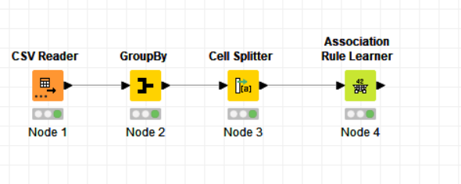
KNIME Workflow
Here, we are using Support and confidence threshold values to get the Lift score for rules.
Support used is 0.05 and minimum confidence level is 0.4

Slide 16
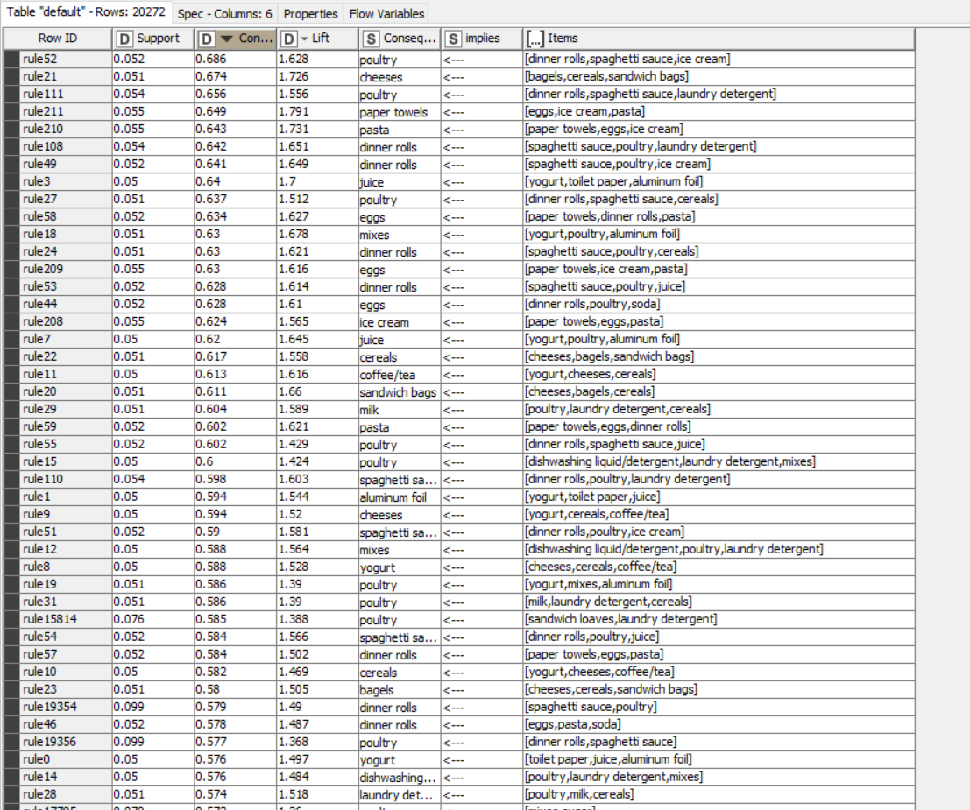
OUTPUT TABLE
This output is based on the decreasing
order of support and lift scores.

Slide 17
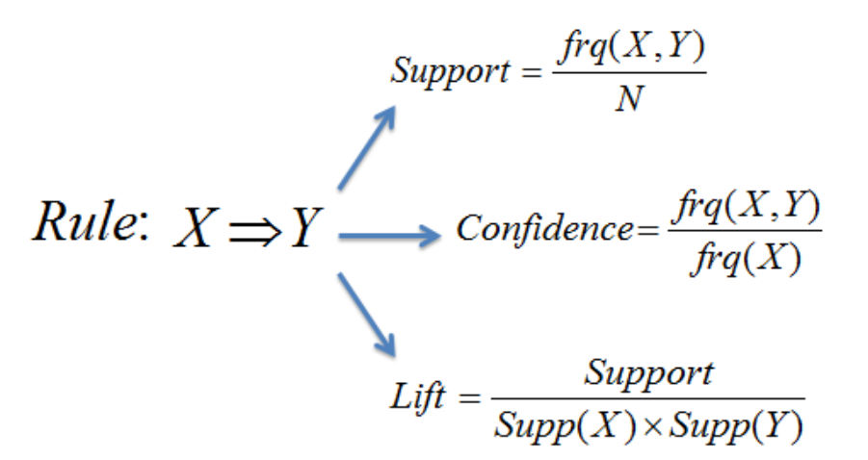
Association Rules

Slide 18
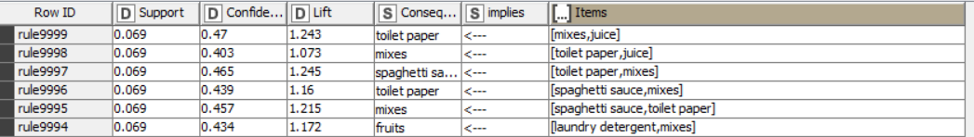
In this snippet of our output table, we can see many parameters.
We can use Lift, together with Support and Confidence measures, to determine which association rules between
products in a market basket are the strongest. Therefore, we can rank them and prioritize marketing actions around them.
Here, in our dataset we are getting almost similar values for different rules.
The lift here determines how well a consequence goes with the combo.
If the lift is low, bundling them together doesn’t have any effect on how many you would sell.

Slide 19
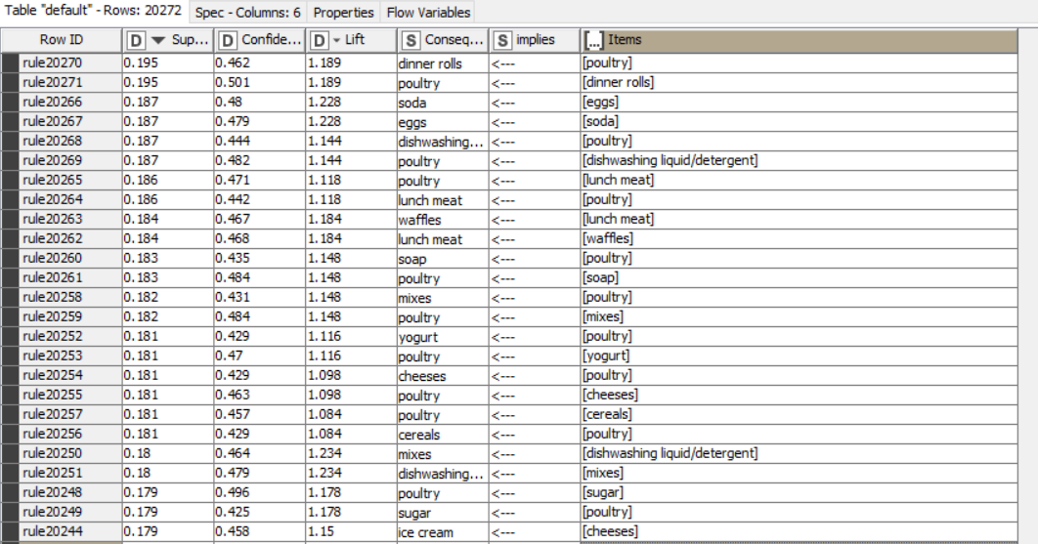
Decreasing order of Lift and Support

Slide 20
Identified Combos from Market Basket Analysis
Combo 1: poultry and dinner rolls
Combo 2: eggs and soda
Combo 3: poultry, lunch meat and waffles
Combo 4: dishwashing liquid/detergent and mixes
Combo 5: poultry, yoghurt, milk and cheese
Combo 6: Sandwich bags and tortillas
These are the combos which have all 3: lift, support and confidence metrics in good values.
Thus, they are highly ordered and their combos can benefit the store.

Slide 21
THANK YOU!!

